Slide 1
Investigating Context Adaptation Bugs in Code Clones
Authors
Manishankar Mondal
Postdoctoral Fellow
Computer Science Department
University of Saskatchewan
Banani Roy
Assistant Professor
Computer Science Department
University of Saskatchewan
Chanchal K. Roy
Professor
Computer Science Department
University of Saskatchewan
Kevin A. Schneider
Professor
Computer Science Department
University of Saskatchewan
ICSME, 2019, Cleveland OH USA, September 30 to October 4, 2019

Slide 2
Code Clones
Code Clones: Code clones are exactly or nearly similar code fragments in a code base disregarding the comments and indentations.
Clone Class: A group (two or more) of similar code fragments forms a clone class.
Types of clones
Type 1
Type 2
Type 3
Type 4
Notes:
As written in the slide.

Slide 3
Type 1 Clones
Comment
public void isPrime (int n)
{
int i = 1, j = 1, k = 1;
for (i = 2; i <= n-1; i++)
{
if (n%i == 0)
{
System.out.println ("not prime");
break;
}
}
if (i == n)
{
System.out.println ("prime");
}
}
public void isPrime (int n)
{
int i = 1, j = 1, k = 1;
//whether n is prime or not
for (i = 2; i <= n-1; i++)
{
if (n%i == 0)
{
System.out.println ("not prime");
break;
}
}
if (i == n)
{
System.out.println ("prime");
}
}
Example of Type 1 clone fragments
Notes:
Type 1 clones are exactly the same code fragments in a code-base.
The two code fragments in the slide are Type 1 clones of each other. We see that there is a comment in the right side fragment. If we disregard this comment, these two code fragments become exactly the same.

Slide 4
Type 2 Clones
Different variable names (n is replaced with num)
public void isPrime (int n )
{
int i = 1, j = 1, k = 1;
for (i = 2; i <= n - 1; i++)
{
if ( n % i == 0)
{
System.out.println ("not prime");
break;
}
}
if (i == n )
{
System.out.println ("prime");
}
}
public void isPrime (int num )
{
int i = 1, j = 1, k = 1;
for (i = 2; i <= num - 1; i++)
{
if ( num % i == 0)
{
System.out.println ("not prime");
break;
}
}
if (i == num )
{
System.out.println ("prime");
}
}
Example of Type 2 clone fragments
Notes:
Type 2 clones are syntactically similar code fragments. These are mainly created from Type 1 clones because of renaming variables or changing data-types.
The left side code fragment in the slide contains a variable called ‘n’. This variable has been renamed as ‘num’ in the right side fragment. Thus, these two code fragments become Type 2 clones of each other.

Slide 5
Type 3 Clones
A new line is added
public void isPrime (int n)
{
int i = 1, j = 1, k = 1;
for (i = 2; i <= n-1; i++)
{
if (n%i == 0)
{
System.out.println ("not prime");
break;
}
}
if (i == n)
{
System.out.println ("prime");
}
}
public void isPrime (int n)
{
int i = 1, j = 1, k = 1;
for (i = 2; i <= n-1; i++)
{
if (n%i == 0)
{
System.out.println ("not prime");
k = 0 ;
break;
}
}
if (i == n)
{
System.out.println ("prime");
}
}
Example of Type 3 clone fragments
Notes:
Type 3 clones are mainly created from Type 1 or Type 2 clones because of addition or deletion of source code lines.
In the right side fragment, there is a line ‘k = 0’. This line is not present in the left side fragment. As a result, the two code fragments in the slide become Type 3 clones of each other.

Slide 6
Type 4 Clones
public int SumNonRecursive (int n)
{
int i = 0, sum = 0;
for (i = 1; i <= n; i++)
{
sum = sum + i;
}
return sum;
}
public int SumRecursive (int n)
{
if ( n == 0)
{
return 0;
}
else
{
return n + SumRecursive ( n - 1);
}
}
Example of Type 4 Clones
Notes:
Type 4 clones are semantically similar code fragments. According to the literature, if two code fragments perform the same task but are implemented in two different ways, those code fragments become Type 4 clones of each other.
The left side fragment in the slide calculates the summation from 1 to ‘n’ using a for loop. However, the task has been done using recursion in the right side code fragment. Thus, these two code fragments are semantically similar and are Type 4 clones of each other.

Slide 7
Impacts of Clones
Clones have dual but contradictory impacts
Positive impacts
Faster development
Cost reduction
Program comprehension
Negative impacts
Hidden bug propagation
Unintentional inconsistent changes
High instability
Notes:
There is no doubt that clones have some positive impacts during software development. However, as we can see in the slide, clone has some serious negative impacts too.

Slide 8
Impacts of Code Clones
Positive sides of code clones
Krinke, WCRE 2007
Krinke, SCAM 2008
Krinke, IWSC 2011
Hotta et al., IWPSE 2010
Negative impacts of code clones
Lozano and Wermelinger, IWSC 2010
Lozano and Wermelinger, ICSM 2008
Juergens et al., ICSE 2009
Mondal et al., ACR 2012
Lili et al., ICSM 2011
Notes:
A number of studies have identified the positive and negative impacts of code clones.

Slide 9
Bug-Proneness of Code Clones
Existing studies show that code clones are directly related to bugs or inconsistencies in the code base.
Barbour et al., ICSM 2011
Chattergi et al., ESEM 2011
Inoue et al., IWSC 2012
Jiang et al., ESEC-FSE, 2007
Li and Ernst, ICSE 2012
LI et al., OSDI 2004
Steidl and Göde, IWSC 2013
Xie et al., MSR 2013
Around 10% to 40% of the bug-fix commits can occur for fixing bugs in code clones.
Notes:
A number of studies show that code clones are directly related to bugs and inconsistencies in the code base.

Slide 10

Motivation: Context Bug
There is a common belief that if a copied fragment is not properly adapted to its own context, the fragment might contain a bug. We call this bug a context adaptation bug (i.e., context-bug) in our research.
Cloning
Copied code fragment
Original code fragment
Context
There was a context adaptation problem
Source File 1
Source File 2
Notes:
There is a common belief that if a copied fragment is not properly adapted to its own context, the fragment might contain a bug/inconsistency. We call this bug a context adaptation bug (or context bug) in our research.
Although there are many studies on clone bug-proneness, we still do not know how many of these bugs are context adaptation bugs. An in-depth investigation on context bugs might help us gain insight into risky cloning patterns. Such an investigation can also help us realize the impacts of code cloning properly.
Description of the figure
-----------------------------
Let us assume that a software system contains a source code file called ‘Source File 1’. A particular code fragment from this file has been copied to another file called ‘Source File 2’. However, the fragment in Source File 2 needs to be adapted to its surrounding context. If a developer fails to perform this adaptation, the copied fragment might appear as a buggy fragment. The bug in such a fragment has been called a context bug in our research.

Slide 11
Motivation: Context Bug
Commits
C1 C2 C3 C4 C5 C6 C7
CF 1
Clone Fragments
CF 2
CF 1 was created
CF 2 contains a context bug
The context bug in CF 2 was fixed
CF 2 was created from CF 1 through copy/pasting. However, CF 2 was not properly adapted to its context, and thus, it contains a bug.
Notes:
Let us have an evolutionary explanation of a context bug.
The slide shows the evolutionary history of two clone fragments, CF1 and CF2, through seven commit operations (C1 to C7). CF1 was created in the first commit operation C1. However, CF2 was created from CF1 in commit C3. Then in commit C6, it experienced a bug-fix. Before experiencing the bug-fix, CF2 did not experience any change. CF1 did not experience a bug-fix. In such a situation, we realize that CF2 was not properly adapted in its context when it was created from CF1 in commit C3. As CF1 did not experience a bug-fix, we can say that it was not buggy in its own context. Finally, CF2 contained a context bug just after its creation and it was fixed in commit C6.

Slide 12
Example 1: Context Bug-fix in Type 2 clones
Revision 524 Clone Fragment 1
Revision 525 Clone Fragment 1
static int skipOverCplusComment (void) {
int c;
while ((c = fileGetc ()) != EOF) {
if (c == BACKSLASH)
fileGetc ();
else if (c == NEWLINE)
break; }
static int skipOverCplusComment (void) {
int c;
while ((c = fileGetc ()) != EOF) {
if (c == BACKSLASH)
fileGetc ();
else if (c == NEWLINE)
break; }
No Change
Revision 524 Clone Fragment 2
Revision 525 Clone Fragment 2
static int skipToEndOfString (void) {
int c;
while ((c = fileGetc ()) != EOF) {
if (c == BACKSLASH)
fileGetc ();
else if (c == DOUBLE_QUOTE)
break; }
static int skipToEndOfString (boolean ignoreSlash) {
int c;
while ((c = fileGetc ()) != EOF) {
if (c == BACKSLASH && ! ignoreSlash)
fileGetc ();
else if (c == DOUBLE_QUOTE)
break; }
Changes
Notes:
There were two Type 2 clone fragments in Revision 524 of Ctags. The commit operation which was applied on Revision 524 was a bug-fix commit.
There were no changes to the first fragment in the commit operation.
However, there were some changes in the second clone fragment. We see that the parameter was updated and the corresponding changes were made to the if condition.
The bug-fix commit message
------------------------------------
(bug #1515910) add support for C# verbatim string literals such as @"C:\" which causes ctags 5.6 to swallow everything up to the next ".

Slide 13
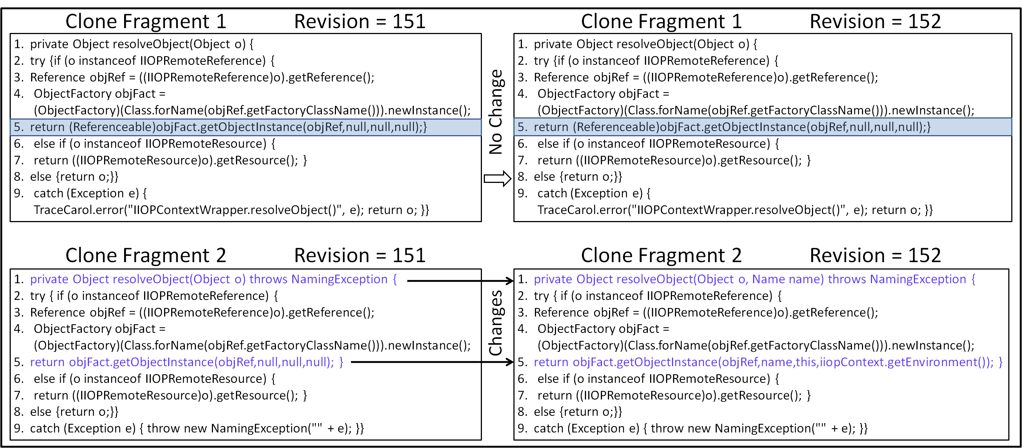
Example 2: Context Bug-fix in Type 3 clones
return (Referenceable) objFact.
getObjectInstance(objRef,null,null,null);}
return (Referenceable) objFact.
getObjectInstance(objRef,null,null,null);}
private Object resolveObject (Object o) throws NamingException
return objFact.
getObjectInstance(objRef,null,null,null);
private Object resolveObject (Object o, Name name) throws NamingException
return objFact.
getObjectInstance(objRef,name,
this,iiopContext.getEnvironment());
Notes:
This slide contains a real-world example of context bug.
This figure shows an example of context bug-fix in a clone fragment denoted as Clone Fragment 2 (CF2) from our subject system Carol. The bug-fix commit was applied on revision 151. We can see the snapshots of CF2 both in revision 151 and 152. The changes (in Line 1 and Line 5) have been highlighted. The commit message says "Bug 283 correction: IIOP Reference binding problem". The figure contains another clone fragment called Clone Fragment 1 (CF1) in revision 151. Both CF1 and CF2 were created in revision 140 and they make a Type 3 clone-pair. None of these fragments was changed until revision 151 where CF2 experienced the bug-fix change as we have just described. CF1 never experienced a bug-fix. CF1 and CF2 follow the second bug-fix pattern. If we carefully look at CF1 and CF2 and the bug-fix changes experienced by CF2 we realize that the bug that was fixed in CF2 is a context-bug according to our definition. If we look at the lines 1 and 5 of CF1 and CF2 in revision 151, we see that the corresponding lines of the clone fragments are similar except that line 1 in CF2 throws an exception which is absent in line 1 of CF1, and line 5 of CF1 contains a type-casting (i.e., \emph{(Referenceable)}) which is not present in line 5 of CF2. However, the bug-fix changes that occurred in CF2 indicate that CF2 was not properly adapted to its context at the time of its creation (possibly through copy/pasting from CF1) and the bug, \emph{Bug 283}, was introduced to it. The bug-fix commit adapted it by adding an extra parameter called \emph{name} of type \emph{Name} to it and making corresponding changes in its fifth line.

Slide 14
Example 2: Elaborated
Clone Fragment 1 Revision 151
Clone Fragment 1 Revision 152
.
.
return (Referenceable) objFact.
getObjectInstance(objRef,null,null,null);}
.
.
.
.
return (Referenceable) objFact.
getObjectInstance(objRef,null,null,null);}
.
.
Clone Fragment 2 Revision 151
Clone Fragment 2 Revision 152
.
.
return objFact.
getObjectInstance(objRef,null,null,null);
.
.
.
.
return objFact.
getObjectInstance(objRef,name,
this,iiopContext.getEnvironment());
.
.
Bug-fix
Notes:
We elaborate the previous example in this slide. The upper two boxes show the corresponding unchanged portion of the unchanged clone fragment. The lower two boxes show the changes that occurred in the other clone fragment.

Slide 15
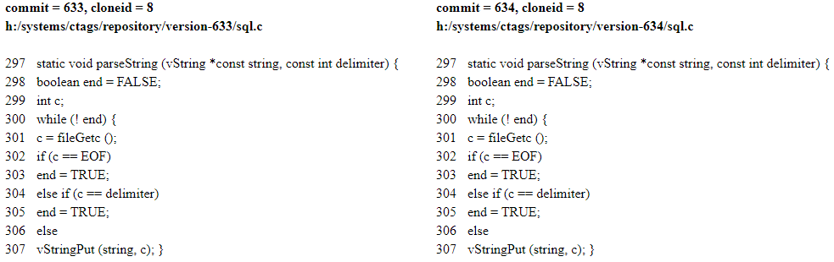
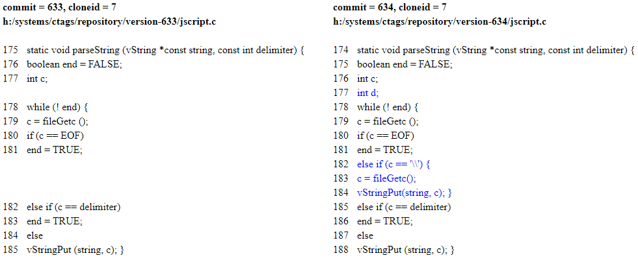
Example 3: Context bug-fix in Type 1 clones
Notes:
Our implementation obtain this example from Type 1 clones of Ctags

Slide 16
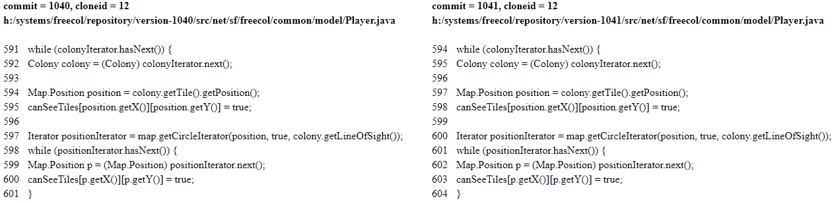
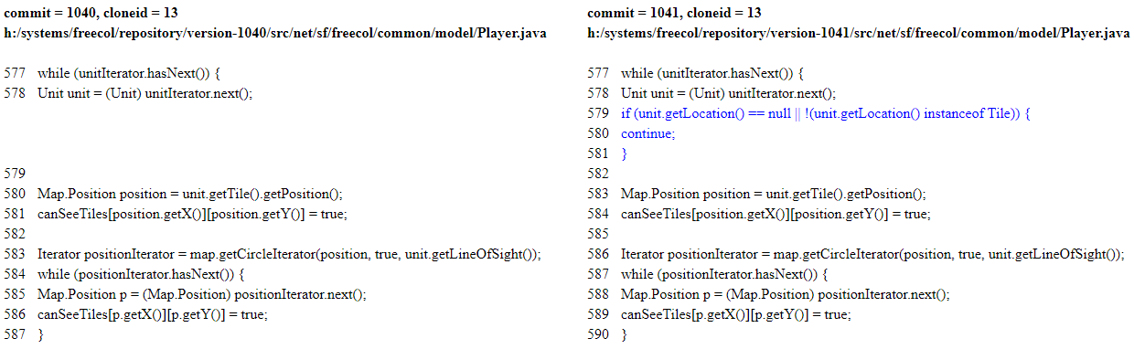
Example 4: Context bug-fix in Type 2 clones
Notes:
Our implementation obtain this example from Type 2 clones of Freecol

Slide 17
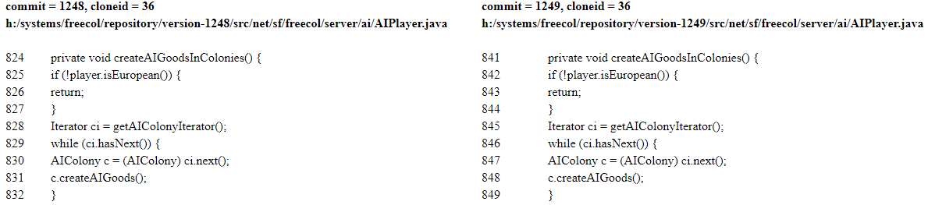
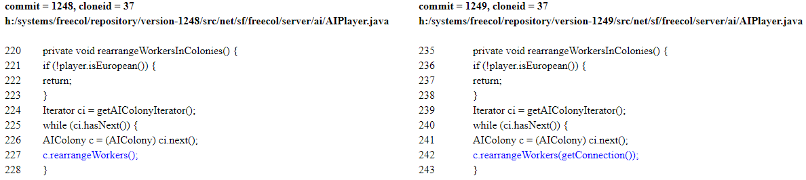
Example 5: Context bug-fix in Type 2 clones
Notes:
This is an example from Type 2 clones of Freecol

Slide 18
Motivation
Likeliness of context adaptation bugs is still unknown.
Realizing the impacts of code clones
Notes:
Many studies have been done on the bug-proneness of code clones. However, none of the preexisting studies investigated how often clone fragments contain context bugs.
Without investigating context bugs, we cannot properly realize the impact of code clones on software evolution and maintenance.

Slide 19
Context Bug-fix Patterns
We investigate two bug-fix patterns that indicate fixing of context bugs.
We will describe these patterns in the next slides.
Notes:
As written in the slide.

Slide 20
Context Bug-fix Patterns: Pattern 1
Commits
C1 C2 C3 C4 C5 C6 C7
CF 1
Clone Fragments
CF 2
CF 1 was created
CF 2 was created
CF 2 had no change
CF 2 experienced a bug fix
CF 1 and CF 2 make a clone pair
Notes:
The slide shows the evolution of two code fragments CF1 and CF2 through seven commit operations: C1 through C7. CF1 is older than CF2 because they were created in the commits C1 and C3 respectively. Moreover, just after the creation of CF2, the fragments CF1 and CF2 make a clone-pair. CF2 experienced a bug-fix change in the commit operation C6. The figure also indicates that CF2 did not experience any change before experiencing the bug-fix (i.e., in the commits C4 and C5). Moreover, CF1 did not experience a bug-fix. In this scenario, it is expected that CF2 contained a context bug just after its creation and the bug was fixed in C6. This is our first pattern of bug-propagation.

Slide 21
Context Bug-fix Patterns: Pattern 2
Commits
C1 C2 C3 C4 C5 C6 C7
CF 1
Clone Fragments
CF 2
CF 1 was created
CF 2 was created
CF 2 had no change
CF 2 experienced a bug fix
CF 1 and CF 2 make a clone pair
Notes:
This slide explains the second pattern (Pattern 2) using an example. The evolutionary scenario in this slide is similar to the scenario depicted in the previous slide with the exception that both of the fragments CF1 and CF2 in this slide were created in the same commit operation (i.e., C1). In the previous slide, CF1 and CF2 were created in different commits. Finally, this slide presents an evolutionary scenario which we call the second pattern of context bug-fix. CF2 contained the bug just after its creation in commit C1.

Slide 22
Detecting Context Bug-fix Patterns
Identify the Potential Clone-Pairs
Potential Clone-Pairs
Analyze the past evolution of the potential pairs
Notes:
For detecting context bugs, we first identify the potential clone pairs. For each of these potential pairs, we analyze its past evolution in order to realize whether the fragments in the pair evolved by following any of the two patterns.

Slide 23
Potential Clone-Pair
Bug-fix Commit Operation
Unchanged clone fragment
Past Evolution
Changed clone fragment
A potential clone pair
in Revision R
Notes:
This figure shows an example of a potential clone pair. We see that there is a clone pair (i.e., the two circles) in revision R of a subject system. The commit operation that was applied on this revision is a bug-fix commit and one of the two clone fragments was changed in this bug-fix commit. In each of our two patterns described previously we saw that one fragment experiences the context bug-fix, however, the other fragment does not. Thus, the clone-pair where one of the two fragments in the pair experienced a bug-fix is considered a potential clone pair. After identifying such a pair, we analyze its past evolutionary history. If the past evolutionary history of such a clone-pair matches any of the two previously described patterns (i.e., pattern 1 and pattern 2), we realize that the potential clone pair evolved by following a context bug-fix pattern.

Slide 24
Experimental Setup: Subject Systems
Subject Systems
Lang. | Systems | Application Domain | LOC | Revisions
Java | Freecol | Game | 91,626 | 1,950
 | jEdit | Text Editor | 1,91,804 | 4,000
 | Carol | Game | 25,092 | 1,699
 | Jabref | Reference Management | 45,515 | 1,545
C | Ctags | Code Definition Generator | 33,270 | 774
C# | MonoOSC | Formats and Protocols | 14,883 | 355
Notes:
We perform our investigation on six subject systems as listed in the table. Four of these systems were implemented in Java programming language. The remaining two were implemented in C and C#. We see that the subject systems are of diverse variety in terms of size (LOC), application domains, and revision history lengths (number of revisions).

Slide 25
Experimental Setup: Clone Detection
We have used NiCad clone detector [Cordy and Roy, ICPC 2011] for detecting clones because NiCad can detect the major three types of clones (Type 1, Type 2, and Type 3) with high precision and recall [Roy et al., SCP 2009] [Svajlenko and Roy, ICSME 2014].
We consider all three major types of clones in our experiment.
We detect block clones of at least 10 LOC with 30% dissimilarity threshold and blind renaming of identifiers.
Notes:
We use NiCad clone detector for detecting clones because NiCad can detect three types of code clones separately, and with high precision and recall. We detect block clones of at least 10 LOC with 30% dissimilarity threshold and blind renaming of identifiers. We use these settings because in a study published in ICSME 2014 it was found that these settings provide us with better clone detection results in terms of precision and recall.

Slide 26
Experiment Steps
Method Detection and Extraction from Each Revision
Methods in Each Revision
All Revisions of a Subject System
Locating Clones to Methods in Each Revision
Locating Changes to Methods and Clones
Change Detection between Consecutive Revisions
Extraction of Clones from Each Revision
Clones in Each Revision
Method Genealogy Detection
Detecting and Analyzing the Context Bug-fix Patterns
Detection of Bug-fix Clones
Clone Genealogy Detection
Clones and methods are identified by file path, and start and end line numbers
Identification of Bug-fix Commits
Notes:
The experimental steps that we complete are as follows:
---------------------------------------------------------------------
Extraction of all revisions of each of the subject systems from the online SVN repository.
Method detection and extraction from each of the revisions.
Detection and extraction of code clones from each revision.
Detection of changes between every two consecutive revisions.
Locating these changes to the already detected methods and clones of corresponding revisions.
Locating the code clones detected from each revision to the already detected methods of that revision.
Detection of method genealogies using the technique proposed by Lozano and Wemelinger []
Detection of clone genealogies by identifying the propagation of clones through the method genealogies.
Identifying code clones that experienced bug-fixes.
Detecting and analyzing the context bug-fix patterns.

Slide 27
Answering RQ 1
RQ 1: What proportion of clone-related bug fixes are associated with context-bugs?
For answering RQ 1
We first identify all the bug-fix changes that were experienced by code clones
We then identify which of these bug-fix changes occurred for fixing context bugs
Notes:
We have answered four research questions through our investigation. The first question is written here. For answering this question, we perform the following two things:
We first identify all the bug-fix changes that were experienced by code clones
We then identify which of these bug-fix changes occurred for fixing context bugs

Slide 28
Answering RQ 1
Notes:
Out of 19 bug-fixes experienced by the Type 1 clones of jEdit, 16 were context bug-fixes.
We obtain this graph by plotting our experimental data.
This graph shows the percentage of context bug-fixes with respect to all bug-fixes in code clones considering each clone-type of each of our subject systems. We see that Type 1 clones of jEdit shows the highest percentage (84%) of context bug-fixes. According to our experimental data, out of 19 bug-fixes experienced by the Type 1 clones of jEdit, 16 were context bug-fixes. We also determine the overall percentage of context bug-fixes considering all clone-types of all subject systems. We observe that overall around 50% of the bug-fixes experienced by code clones can be context bug-fixes.
We see that there is no bar for the Type 2 case of MonoOSC. Actually, the Type 2 clones of MonoOSC did not experience any bug-fix.

Slide 29
Answer to RQ 1
A considerable proportion of the bug-fixes in code clones can occur for fixing context bugs.
The overall proportion considering all subject systems and clone types is around 50%.
Notes:
As written in the slide.

Slide 30
Answering RQ 2
RQ 2: Which pattern of context bugs is more likely to occur during software evolution?
For answering RQ 2
We identify all those bug-fixes that indicate context-fixes in code clones.
We then determine which bug-fixes followed the first pattern and which ones followed the second pattern.
Notes:
As written in the slide.

Slide 31
Answering RQ 2
Notes:
This slide shows a stacked bar graph showing the percentages of Pattern 1 or Pattern 2 context bug-fixes with respect to all context bug-fixes. We see that there are seventeen bars in the figure. For Type 2 case of our subject system, MonoOSc, we did not get any context bug-fixes. For most of the bars in the figure except for three bars (i.e., the bars regarding Type 3 case of Ctags, Type 1 case of Carol, and Type 3 case of MonoOSC), the percentage of Pattern 2 context bug fixes is much higher than the percentage of Pattern 1 context bug fixes. For Type 3 case of Ctags, the percentage regarding Pattern1 is higher. For the other two cases (Type 1 case of Carol and Type 3 case of MonoOSC), both patterns show the same percentage (50%). We also determine the overall percentages of Pattern 1 and Pattern 2 bug-fixes considering all the context bug-fixes of all clone-types of all subject systems. These overall percentages for Pattern 1 and Pattern 2 are respectively 16.79% and 83.21%. Thus, around 83.21% of the context bug-fixes follow Pattern 2 during evolution.

Slide 32
Answer to RQ 2
The context bug-fixes of Pattern 2 are significantly more likely to occur than those of Pattern 1.
Notes:
We can see the context bug-fix patterns here. In the second pattern, both of the clone fragments were created in the same commit operation. In other words, CF2 was created from a code fragment (CF1) which was not committed before. Thus, copying from an uncommitted code is riskier according to our findings.

Slide 33
Answering RQ 3
RQ 3: Which type of code clones have a high possibility of containing context-bugs?
For answering this research question
We identify which clone fragments of which clone type experienced context-fixes.
We then compare the percentages of context bug-fix clones of the three clone types.
Notes:
As written in the slide.

Slide 34
Answering RQ 3
Notes:
This slide shows the percentages of clone fragments in each clone-type that contained context bugs (i.e., that experienced context bug-fixes). According to the figure, Type 3 clones of our subject system Freecol exhibit the highest percentage (6.5%). According to our experimental data, among 753 Type 3 clone fragments that were created during the whole period of evolution of Freecol, 49 fragments experienced context bug-fixes. From Fig. 7 we also observe that for most of the subject systems except Jabref, Type 3 clones exhibit the highest percentage. In the case of Jabref, the highest percentage is exhibited by the Type 1 clones. We also determine clone-type wise overall percentages considering all subject systems and show these percentages in the figure. Type 3 clones show the highest overall percentage (around 4.67%) among all clone-types. The percentage regarding Type 1 clones is the lowest.

Slide 35
Answer to RQ 3
Type 3 clones generally have the highest possibility of containing context bugs during evolution.
Notes:
As written in the slide.

Slide 36
Answering RQ 4
RQ 4: Does cloning within the same file or cloning across different files promote context bugs?
For answering this research question
We first identify which clone pairs in each clone-type evolved by following the context bug-fix patterns.
We then identify whether the two clone fragments in each such pair resides in the same file or in different files.
Notes:
As written in the slide.

Slide 37
Answering RQ 4
Notes:
We determine the percentages of same-file-pairs and different-files-pairs with respect to all clone-pairs that followed the context bug-fix patterns, and show these percentages in the stacked bar-graph in this slide for each clone-type of each subject system. The figure shows seventeen bars in total. For Type 2 case of MonoOSC, we did not get any clone-pair that followed any of the context bug-fix patterns. The figure does not contain a bar for this case. For most of the other cases (i.e., for 13 out of 17 cases), the percentage of different-files-pairs is higher than the percentage of same-file-pairs. By considering all clone-types of all subject systems we find that
the overall percentages of different-files-pairs and same-file-pairs are 89.92% and 10.08% respectively.
This is interesting to see that for the Type 1 case of each of our subject systems, all the clone pairs that followed context bug-fix patterns contain clone fragments residing in two different files.

Slide 38
Answer to RQ 4
Clone fragments residing in different files have a higher possibility of containing context bugs compared to clone fragments residing in the same file.
Notes:
As written in the slide.

Slide 39
Discussion
From our manual analysis we realize that context adaptation bugs mostly occur because of not adapting method calls and if conditions in the copied fragments.
Cloning across different files can be riskier than cloning in the same file.
Type 3 clones should be given a higher priority than the other two clone types when making clone management decisions.
Notes:
Programmers should be more careful about method calls and if conditions while cloning.

Slide 40
Conclusion
In our research, we investigate whether code cloning introduces context adaptation bugs in the code-base.
We define two context bug-fix patterns and mine these patterns by analyzing the evolutionary history of our subject systems.
We also investigate context bug-fixes in three different clone-types.
We find that Type 3 clones have a higher possibility of containing context bugs than the other two clone-types. We also identify risky cloning operations that the programmers should avoid for minimizing context-bugs.
Notes:
As written in the slide.

Slide 41
Thanks

